Slide 1
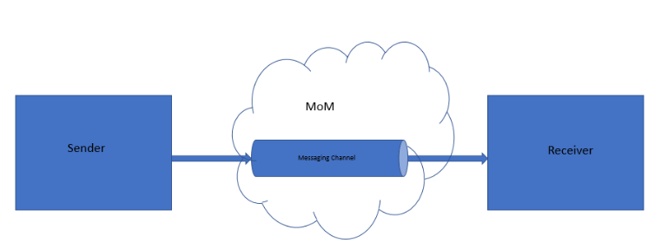

Slide 2
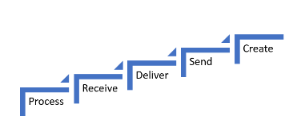

Slide 3

Pipe & Filters Pattern

Slide 4
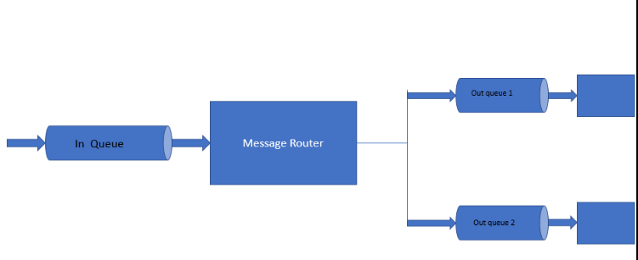
Message Router

Slide 5

Message Translator

Slide 6

Messaging Endpoint

Slide 7


Slide 8
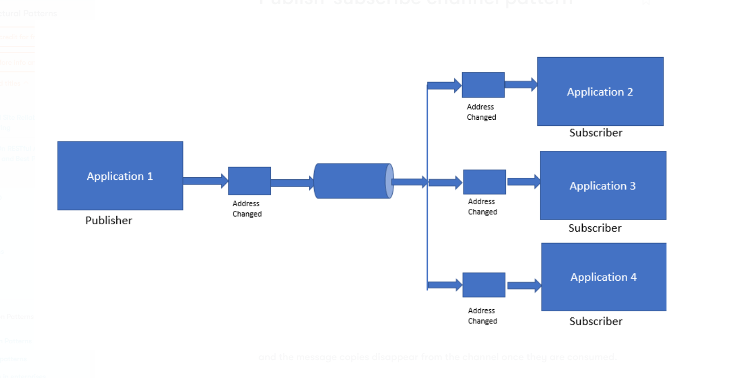

Slide 9
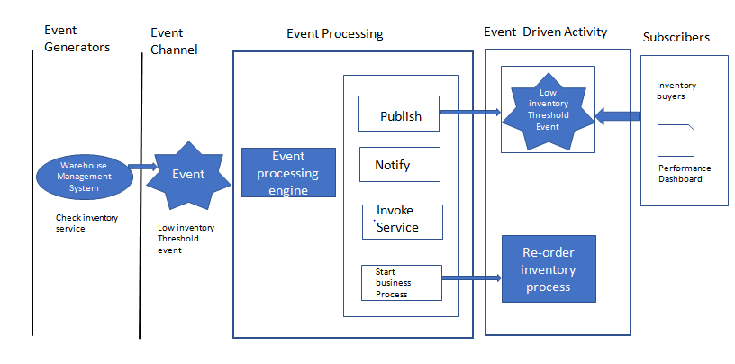

Slide 10
